Slide 1
GMML-Vision
A GMML - visualizor / editor
Sjoerd Crijns

Slide 2
Overview
Introduction
Goal
GMML – Vision
GMML – Vision “1” (designed by former project group)
New GMML – Vision
  (Classes)
  New features
To do
Short demonstration

Slide 3
Introduction
A biological pathway map:
  A graphical representation of a known biochemical pathway
  Essential in understanding the basic biology of an organism
  Result of experimental research
It is diffictult to obtain this information in a digitally accessible format.

Slide 4
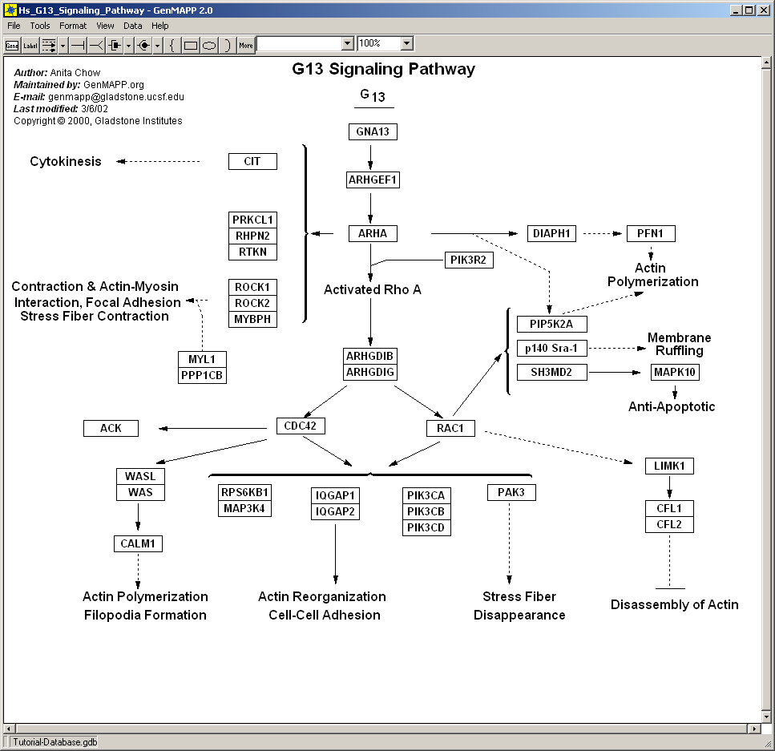

Slide 5
GenMAPP
Application to visualize pathway data
Written in VB
    Slow
    Microsoft Windows only…
Just visual data, no biological information at all

Slide 6
Goal
Developing a platform independent application to visualize and edit pathway data and include biological information

Slide 7
Application: GMML – Vision
GMML – Vision was developed by former project group
  Java – application
    Platform independent
    Good with graphics
  Reactome data in GMML-format used as input
  Worked nice, but...

Slide 8
GMML – Vision “1” – Drawbacks
Inefficient programming
  Not really object oriented
Inconsequent programming
  Different data types for same variables
No apparent structure, internal mess

Slide 9
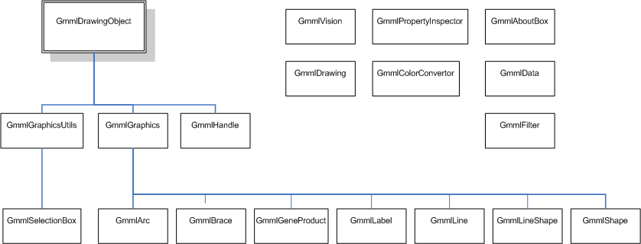
New GMML – Vision application class diagram

Slide 10
New Features
Selection Box
Property Inspector
Zoom
Documentation added

Slide 11
To do
Implement connections
Implement automatic lay-out generation
Implement things like title, author, rotation, etcetera…
Including biological drawing conventions
Fix some bugs…

Slide 12
GMML – Vision
A demonstration

Slide 13
¡¿Que?!

